Slide 1

Crime Trends in Seattle
Anirudh Rao
Karan Murthy
Paromita Banerjee
Shreya Agarwal

Slide 2


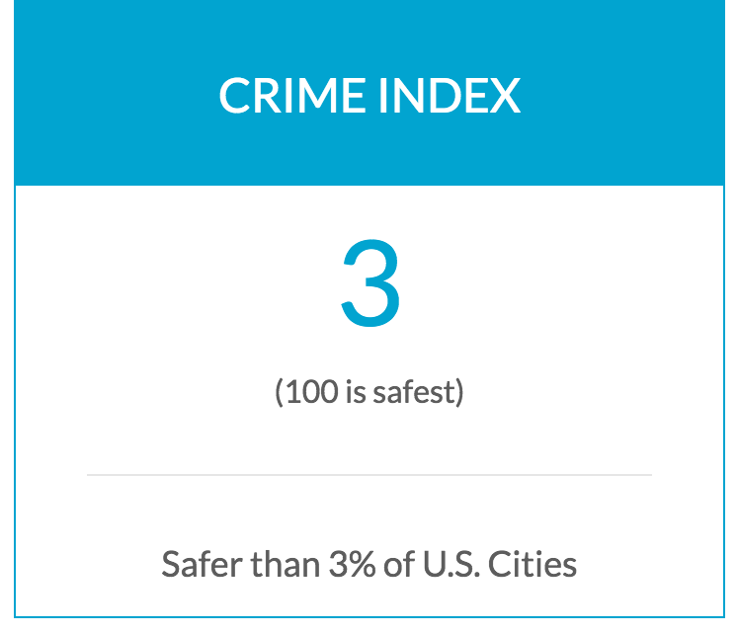
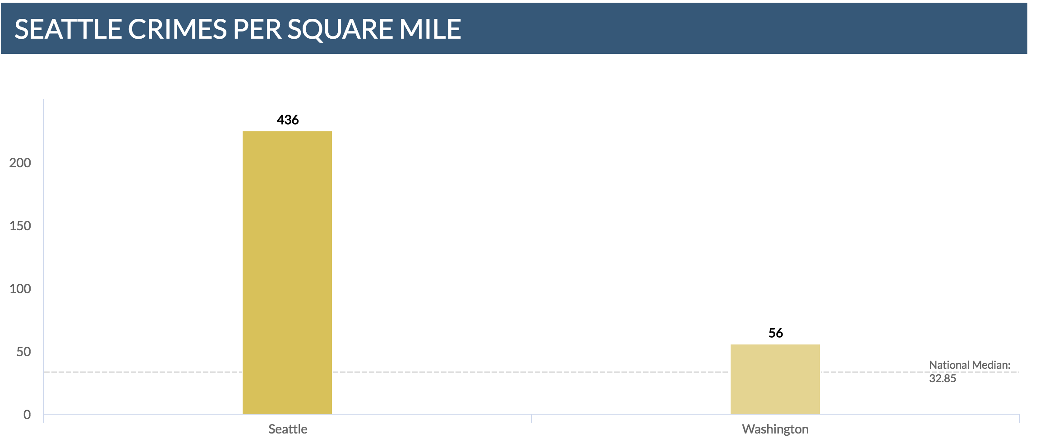
Introduction

Slide 3
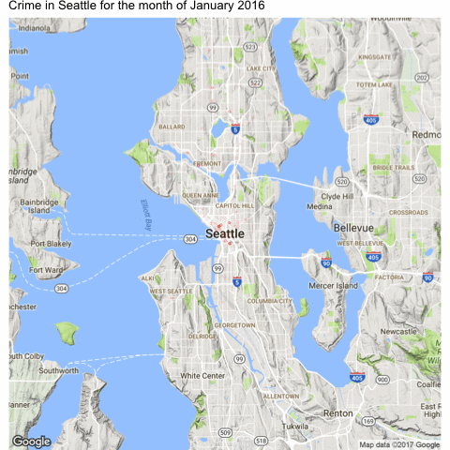
Month wise variation in crime:

Slide 4
About the data
For crime and school data
The crime data has ~81k rows with 19 columns
School data has 116 rows with 11 columns
For housing property data
99 rows with 73 columns

Slide 5
Data Cleaning
Used shape file to extract the neighborhoods for Latitude and Longitude.
Multiple datasets joined by Neighborhood, hence common homogenizing the nomenclature.
Rows with NA values for the variables of interest have been removed.

Slide 6
Research questions
Does the increase in the number of schools in an area increase the occurrence of crimes in that area?
Does the time of the day correlate with the occurrence of assaults?
Does crime in a neighborhood correlate with its property value?
Are there any seasonal variations in the distribution of Crime?

Slide 7
Does the increase in the number of schools in an area increase the occurrence of crimes in that area? H₀: The increase in the number of schools in an area does not increase the incidence of crimes in that area. H_{A}: The increase in the number of schools in an area increases the incidence of crimes in that area.

Slide 8
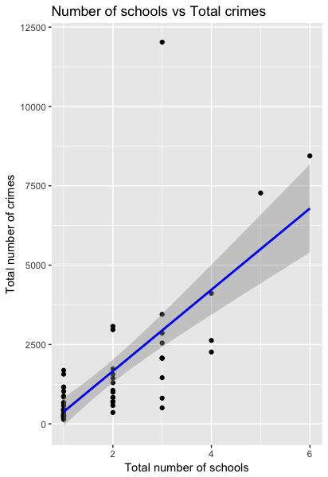
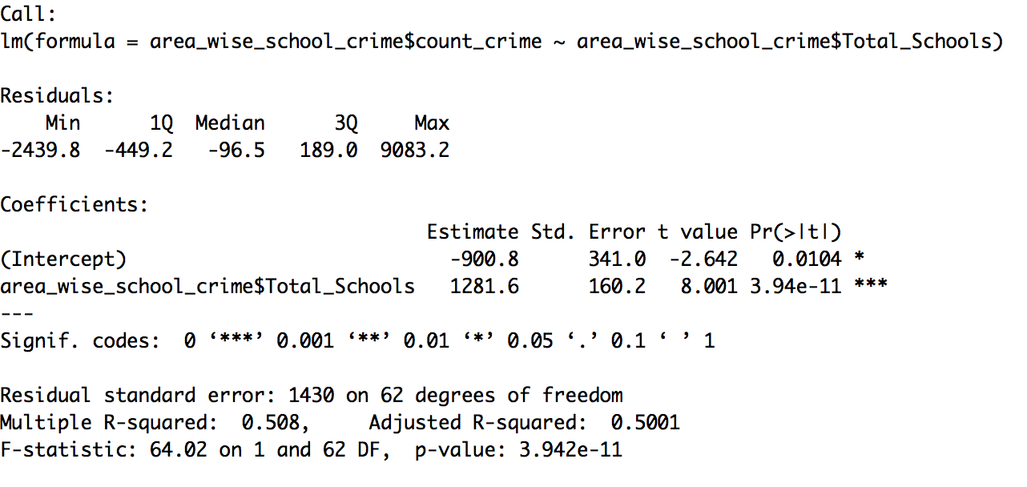
Linear Regression Model

Slide 9
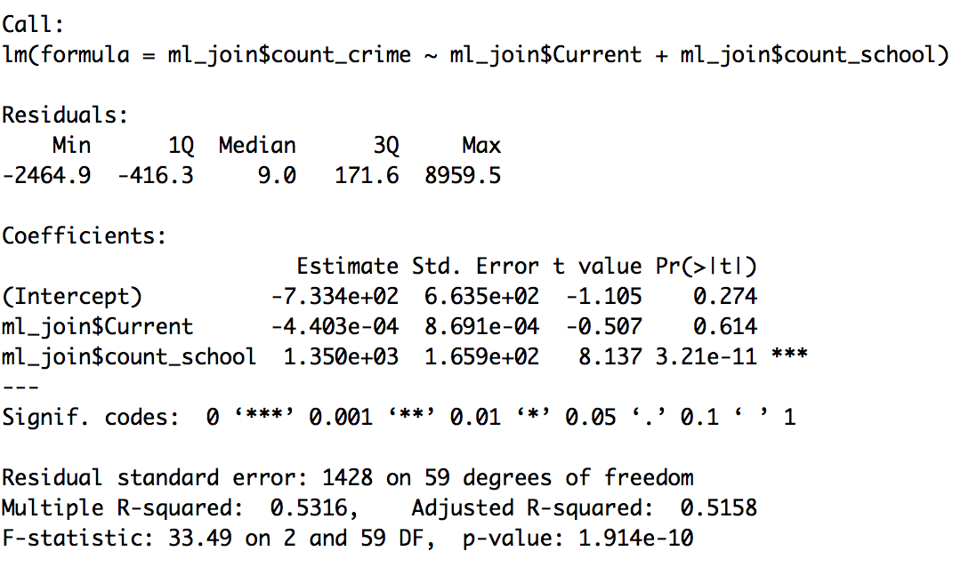
Multiple Regression Model

Slide 10
Does the time of the day correlate with the occurrence of assaults?
H₀ : Time of the day does not correlate with the occurrence of assaults
H_{A} : Time of the day correlate with the occurrence of assaults

Slide 11
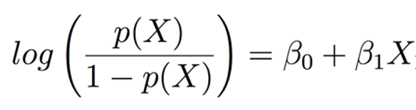
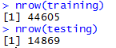
Assaults vs. Time of the day
Logistic Regression:
Response: Assault
Predictor: Time of day
Model:

Slide 12
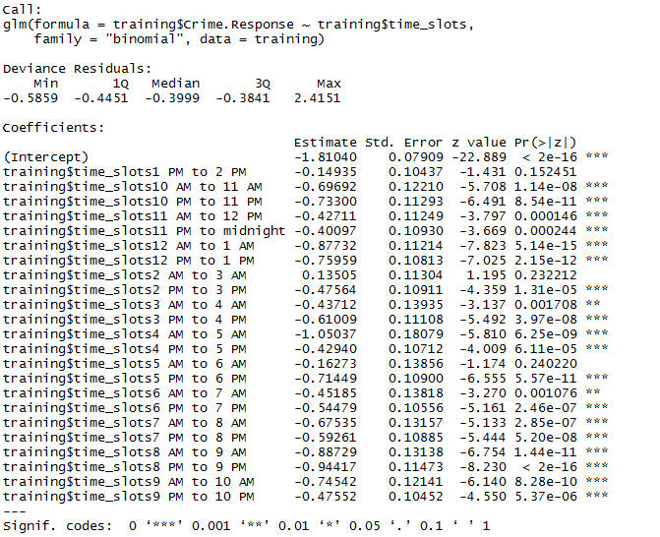
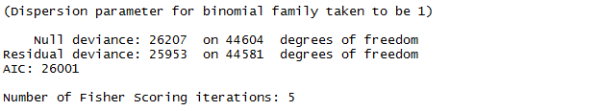
Assaults vs. Time of the Day

Slide 13
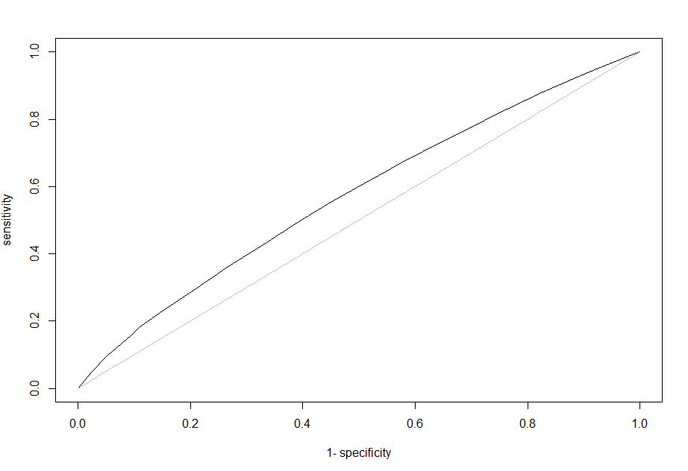
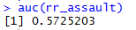
Assaults vs. Time of the Day

Slide 14
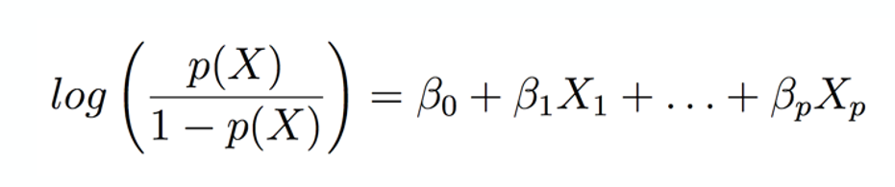
Assaults vs. Time of the day
Multiple Logistic Regression:
Response: Assault
Predictors: Time of day, Neighborhood
Model:

Slide 15
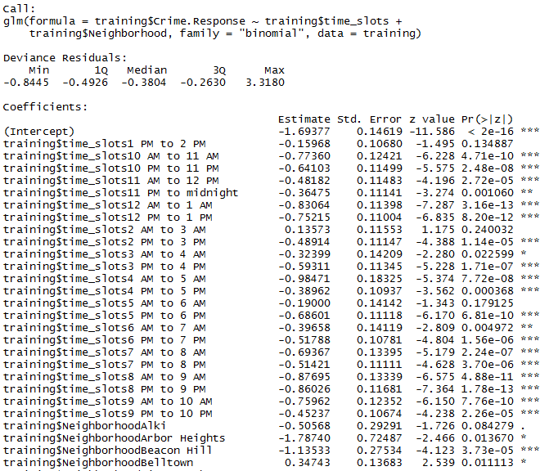
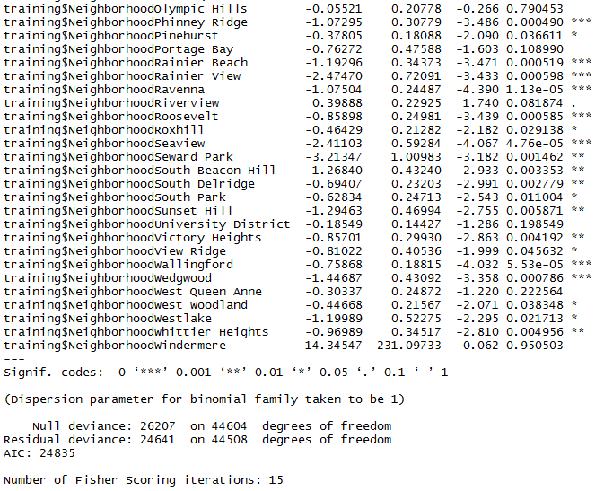
Assaults vs. Time of the Day

Slide 16
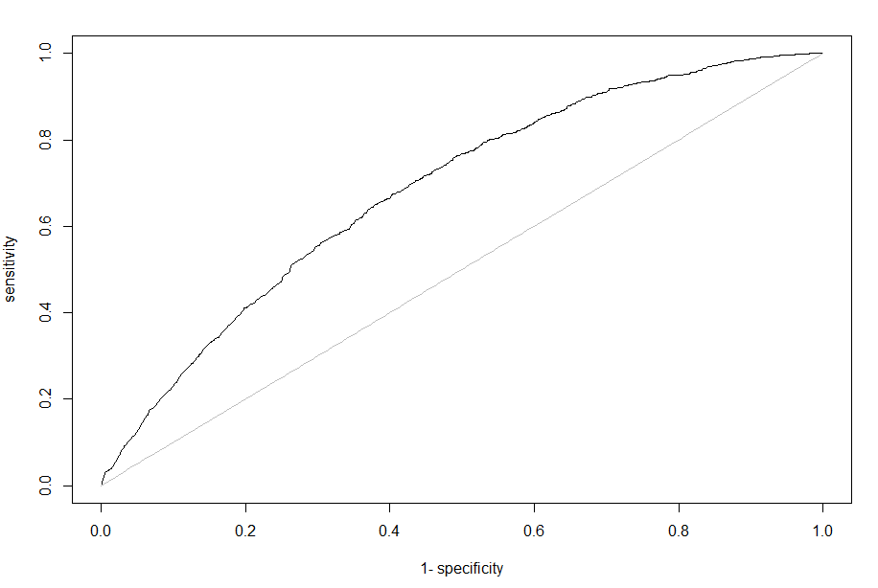
Assaults vs. Time of the Day

Slide 17
Does crime in a neighborhood correlate with its property value?
H₀ : Crime in a neighborhood does not correlate with its property value
H_{A} : Crime in a neighborhood correlates with its property value

Slide 18


Top 3 crime categories in Seattle in 2016
Theft – 21254
incidences
Burglary – 10374 incidences
Vehicle Theft – 7058 incidences incidences

Slide 19

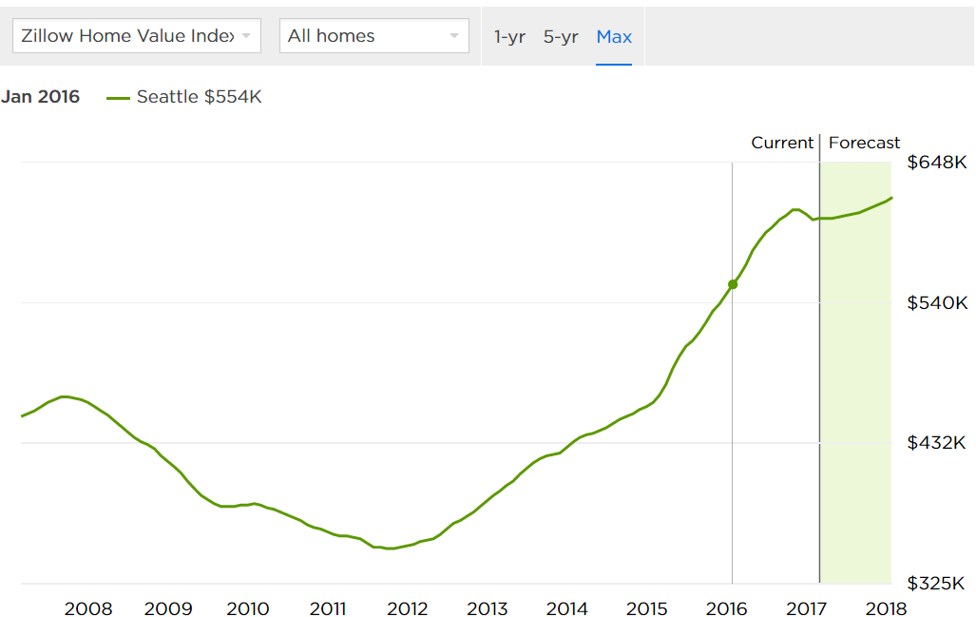
Zillow Data: Property values across 99 neighborhoods in Seattle

Slide 20
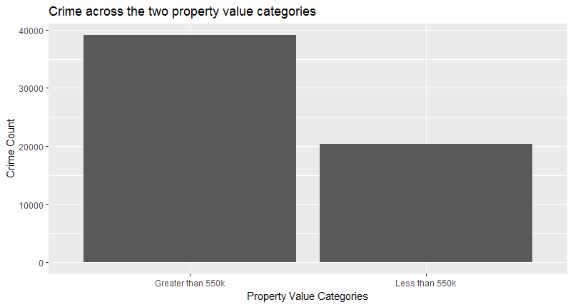
Property value categories
1. Neighborhoods with property value greater than or equal to $5,50,000
2. Neighborhoods with property value less than $5,50,000

Slide 21
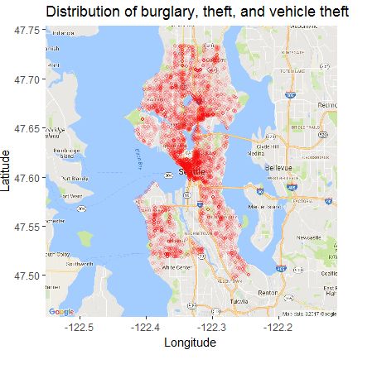
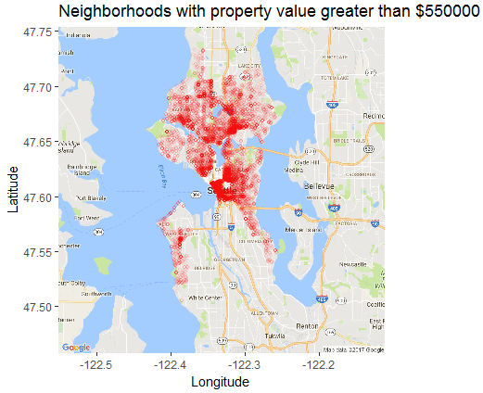
Property vs Crime Comparison

Slide 22
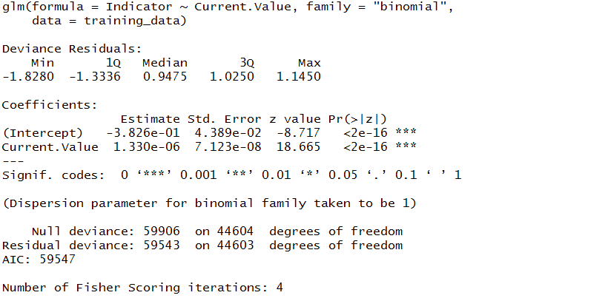
Logistic Regression:
Response : Top 3 crimes (burglary, theft, and vehicle theft)
Predictor: Property values

Slide 23
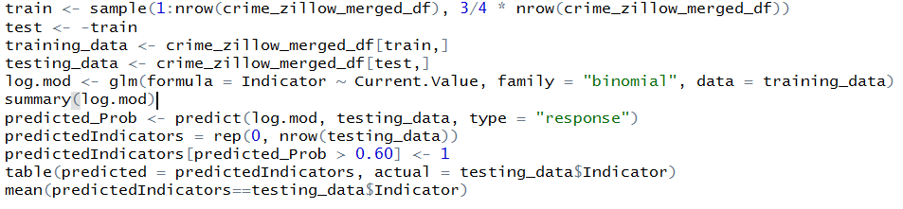
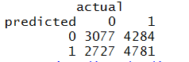
Model Accuracy?
Training data = 75% of total observations
Testing data = 25% of total observations
Cut-off = 60%
Accuracy = 52.84%
Is there any better model?

Slide 24
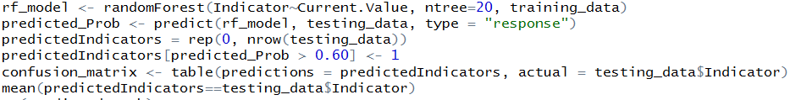
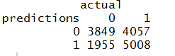
Random Forests
Training data = 75% of total observations
Testing data = 25% of total observations
Cut-off = 60%
Accuracy: 62.56%

Slide 25
Are there any seasonal variations in the distribution of Crime?

Slide 26
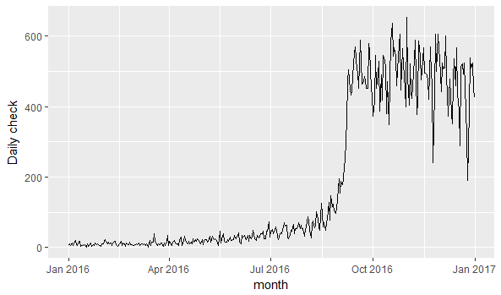
Time Series Analysis of Seattle Crime data of 2016

Slide 27
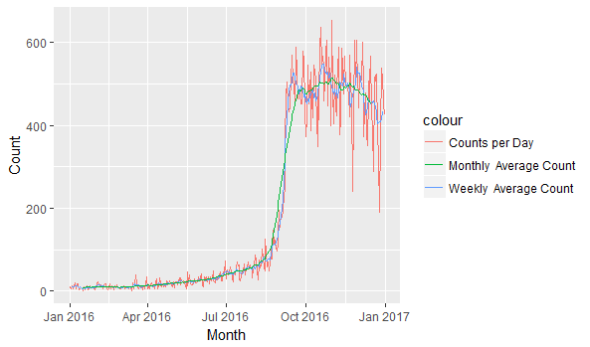

Slide 28
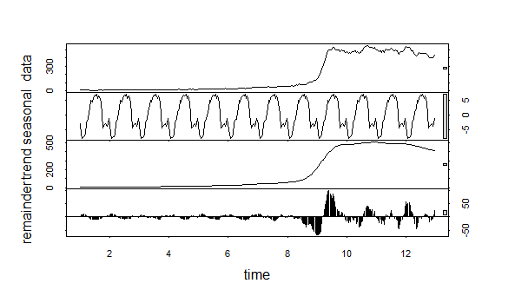
Decomposition of the Time Series

Slide 29
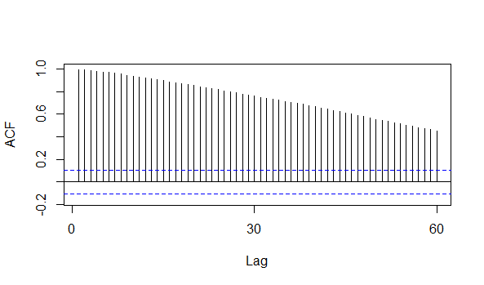
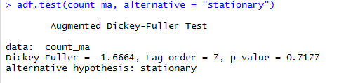
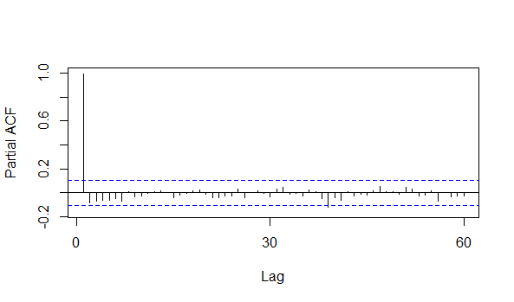
Determining the Stationarity of the Series

Slide 30
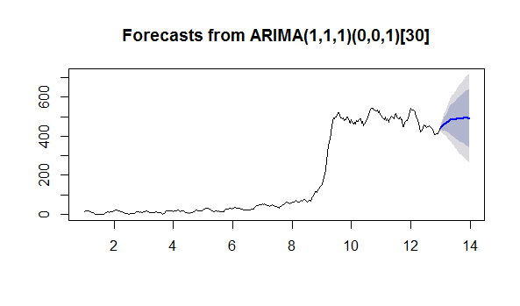
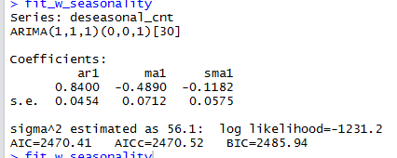

Slide 31
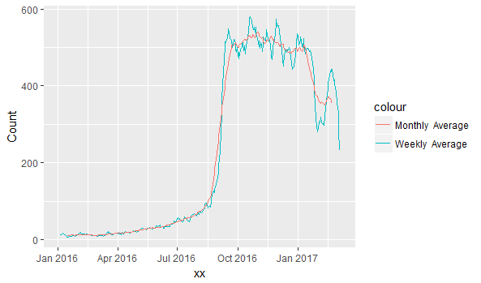

Slide 32
Conclusion
Significant findings:
Although the presence of schools in an area is statistically significant, it might not be a strong predictor of crimes in that particular area
Property value is statistically significant and is a significant predictor of crimes in that particular area
Time series analysis shows that there is a trend of the crime occurring over the months.

Slide 33
Limitations
Data Bias - We find significant amount of skewness in the data
Unavailability of data in standard format
Forecasting is based on one year data
Future Scope
Include other predictors that could help understand the crime scenario in Seattle. Such as :
Demographic Data
Census Data
Weather Data
Collaborate with SPD

Slide 34
Thank you !

